Slide 1
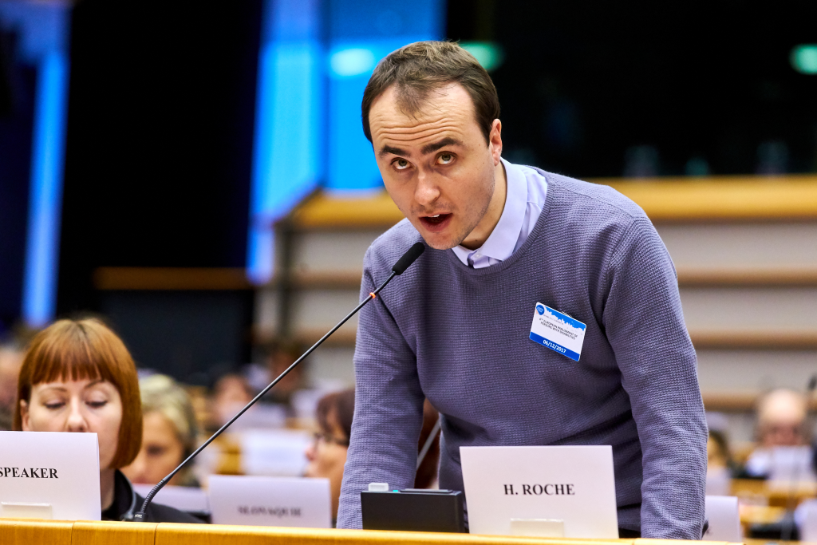
By Harry Roche

Slide 2
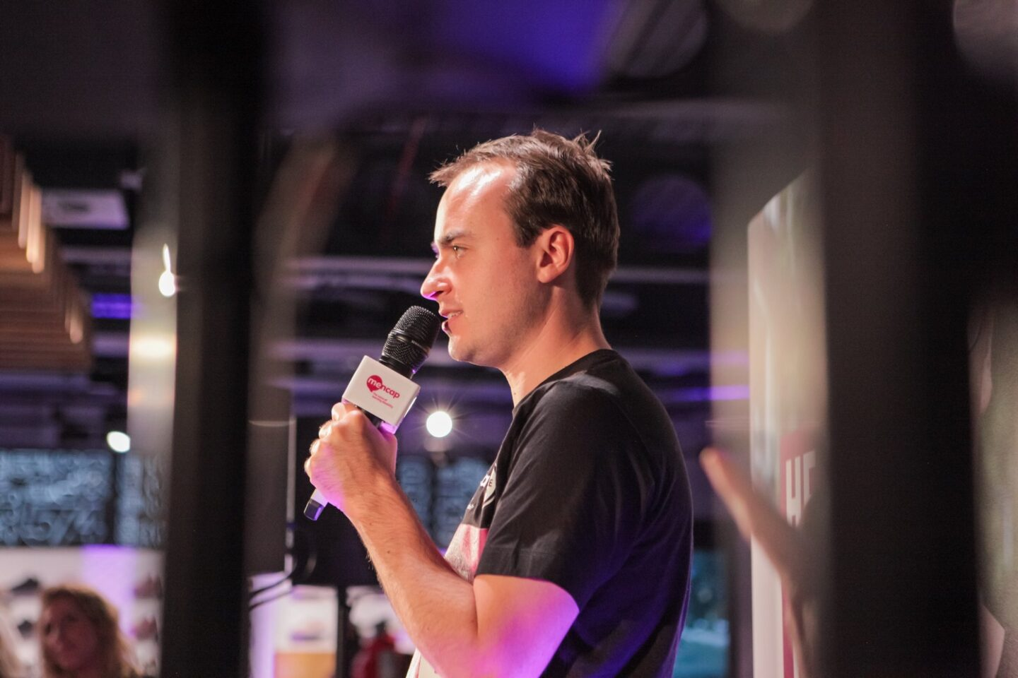
Introduction
I work at Inclusion International as Inclusion Support Officer on secondment from Mencap.
Inclusion International is the global network of people with a Intellectual disabilities and their families.
We advocate for their human rights around the world and we want a world where people with intellectual disability have their rights respected
Notes:
Hello my name is Harry, I am the Inclusion Support Officer at Inclusion International. Inclusion International are a global network of people with a Intellectual disabilities and their families. We advocate for their human rights around the world and we want a world where people with an Intellectual disability having their rights respected. Today I am going to talk about Listen Include Respect which is run by Inclusion international and Down Syndrome International this is our work on participation of people with intellectual disabilities.

Slide 3
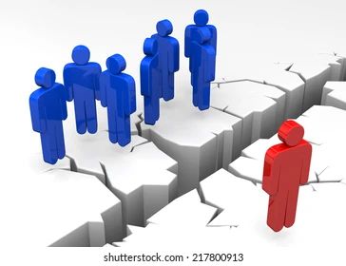
What are some barriers that people with intellectual disability face?
Employment
Access to living the community
Social justice
Education
Accessibility
Notes:
An intellectual disability is sometimes called a learning disability. People with intellectual disabilities have a lot of barrier to taking part in society due to lack of support and understanding but with the right support and right adjustments, we can take part just like anyone else.
Some barriers which stop us taking part, for example are:
Employment for example employers have negative attitudes
Living in the community for example not having choice and control over where to live
Access to justice for example if you have been a victim of discrimination
Education for example special schools which exclude people from getting an inclusive education in their community
Accessibility for example information is not easy to read or in plain language. And services and leisure facilities not being accessible for people who use wheelchairs

Slide 4
What are our rights?
Our rights Under the United Nations CRPD on the rights of persons with disabilities..
Right to get married and have a family
Choosing where to live
Having a job
Living Independently
Making decisions
Participation
https://bit.ly/2UuYuvJ
Notes:
Our rights under the United Nations, Convention on the rights of persons with disabilities, countries that sign up to this treaty must agree to respect the rights of people with a disability. In the CRPD that includes, right to get married and have a family, choosing where to live, having a job,living independently, making our own decisions and the topic we are talking about today taking part in the community.
Countries, including your country, that sign up to the CRPD must make sure that people with disabilities have all their rights. Countries must make sure people can make their own decisions and no one else makes these decisions. Countries are responsible for making things accessible so we can get the information we need for e.g making information easy to read or sign language. Countries are responsible for making sure we can take part alongside everyone else.
Organisations in each country also have a responsibility to respect the rights of persons with disabilities and work towards making sure everyone can participate with no excuses.

Slide 5
What is Listen Include Respect?
Lead by Inclusion International and Down Syndrome International.
We work together to create global guidelines for organizations.
The guidelines will say help organisations to understand how to support people with intellectual disabilities to participate
Notes:
How can you make sure your include people so that everyone can participate in your work.
Listen, Include and Respect is lead by Inclusion International and Down Syndrome International, we work together to create global guidelines for organizations on Inclusive Participation. We want to ensure that people with intellectual disabilities are included and are taking a part in the activities and decision making of organisations. Our goals is to use the knowledge and experience from our members to create useful guidelines for organisations. We also want to create training to support our members and stakeholders to put the guidelines into place.

Slide 6
Why do we need Listen Include Respect?
It is our right to be included and take part!!
People with intellectual disabilities are one of the most excluded groups of people.
We know that organisations want to include people with intellectual disabilities but do not understand how to.
There are no international standards or guidelines for making sure people with intellectual disabilities can participate
Notes:
The CRPD says we have the right to take part in the community and get information in an accessible way BUT people with intellectual disabilities are still one of the most excluded groups of people. People in society think we cannot make decisions or take part. This is wrong! We do not get the support or the accessible information we need to make decisions or take part. When we do get support we have a lot to contribute.
We know that organisations want to include people with intellectual disabilities but do not understand how to.
There needs to be easy to understand and use guidelines on how to include people
There are International standards on accessibility and support for other groups of people with disabilities. For example sign language.
There are no international standards or guidelines for making sure people with intellectual disabilities can participate

Slide 7
What work have we done up until now?
DOMI’s VIDEO https://drive.google.com/file/d/115U9zukhLbX1T9yFiy0Ik60q1INi_PnN/view?usp=sharing
Notes:
Dominique is a self advocate from Argentina. Dominique worked on Listen Include Respect as a consultant. A self-advocate is a person with an intellectual disability who speaks up for their rights and the rights of other people with intellectual disabilities.
As a Self Advocate she is passionate about our rights being respected and advocates for people with Intellectual disabilities to have access to information and to participate without any prejudice or facing any discrimitation. Please watch this video of Dominique explaining the work she was part of on Listen Include Respect

Slide 8
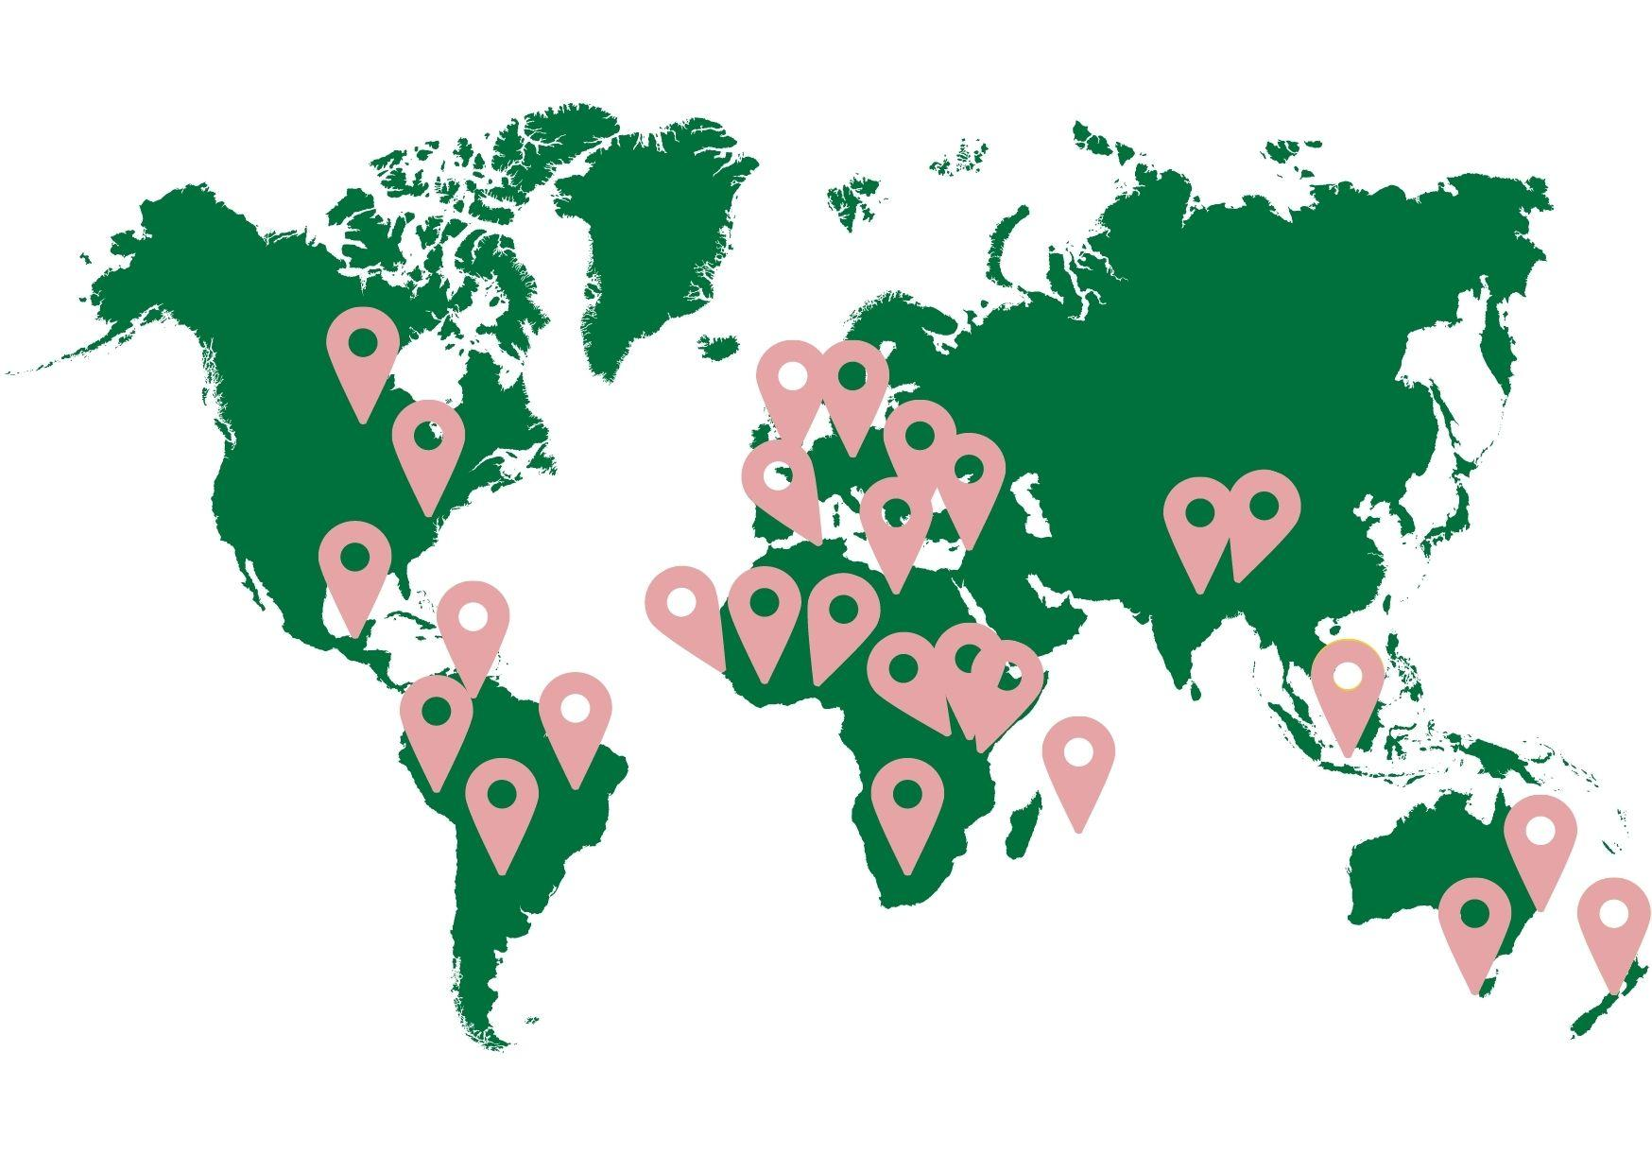
Notes:
We have consulted with many people with intellectual disabilities all around the world to make the guidelines good for everyone.

Slide 9
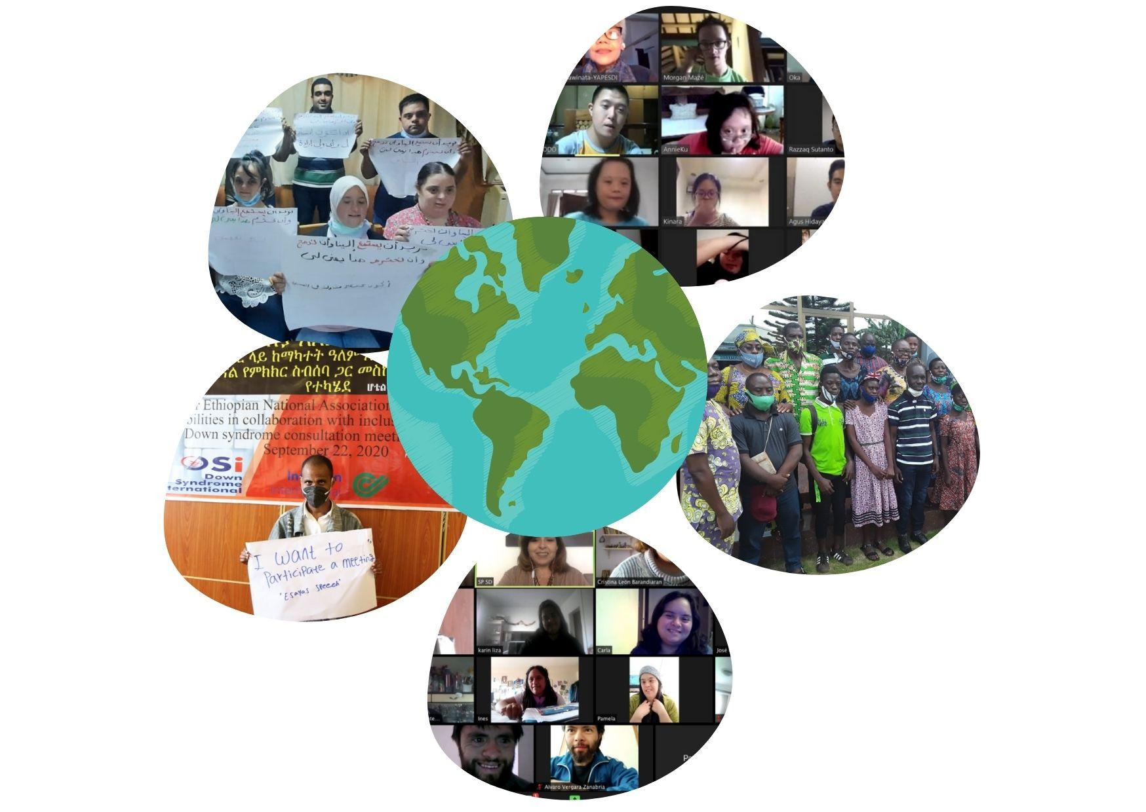
Notes:
We are working on a second draft of the guidelines and they will be ready in 2022!
We will share them with groups like Humanity and Inclusion through the Source website so that you all can understand how to include people with intellectual disabilities in your work.

Slide 10
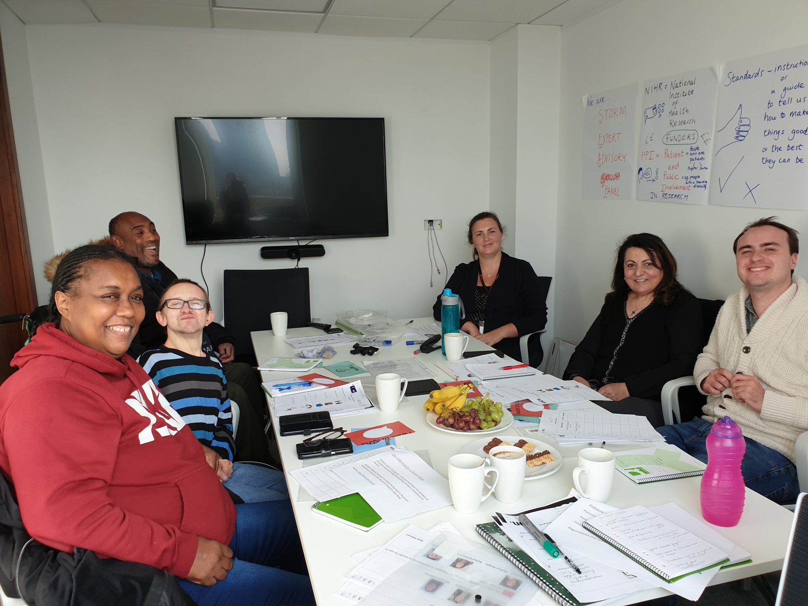
What are my experiences of being included and taking part?
I was included working on research projects with Researchers at University College London.
I was on the Standing Up advisory panel giving researchers advice
I was part of a big research Interviewing Self Advocates on their experience about Standing Up for Myself research.
Notes:
I have worked at Mencap which is a learning disability charity in the UK for nearly 10 years and have felt included at work. My colleagues understand how to support me.
Another experience has been working with researchers. This has been an interesting experience for the last 4 and a half years, I was on an advisory panel giving researchers from University College London advice. I was working on the STORM project this was a project about helping people with Intellectual disabilities to make them feel good about themselves and stand up against negative attitudes.
I was included in all their work and the experience was more good and wasn’t really bad.
To make sure we were included and participating in decision making the team:
Sent agendas in advance in easy read.
Sent the minutes of the meetings so that we could check what was decided
Ran the meetings in an inclusive way with co-chairs with an intellectual disability, we all took turns
Asked for feedback so that we could say what was good about UCL and what was bad so that they could make their work better and more inclusive
I was involved in advising the research team what to do when the pandemic started, I was part of the design team moving the Storm meetings online. Helping the researchers make informations and forms accessible for e.g questionnaires.
The only bad experience was when we were part of a very big group like conference sessions with lots of people like professors and university doctors, there were lots of jargon words and very difficult to follows.
I was able to provide feedback to the UCL researchers about this and they listened.
It is very important that they included self-advocates in this work on intellectual disability. We made their work much better because we were able to participate. They work on intellectual disability but it is people with intellectual disability who have the first hand experience.

Slide 11
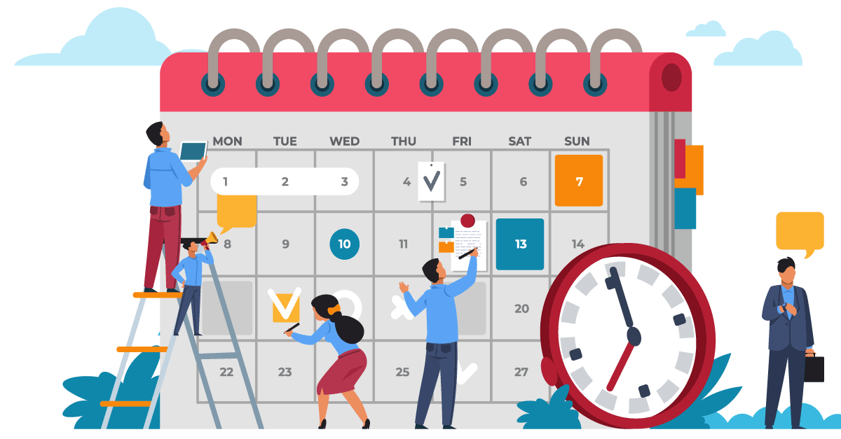
Harry’s top tips for including people with intellectual disabilities in your work so that we can participate
Including self-advocates in the planning from the very start.
Ask and make reasonable adjustments
Make easy read or plain language information.
Do not use jargon
Speak slowly
Give extra time
Notes:
My top tips for including people with intellectual disabilities in your work so that we can participate are that it is very important to include self advocates in the planning of any work from the very start so the work can become accessible at the early stages instead of having to change things later on!
Ask about the adjustments people need to be included.
Make information easy for example use plain language,
think very carefully about your language and take your time when speaking.
Remember we need extra time.
All of these things will be part of the Listen Include Respect guidelines!

Slide 12
Wrap up and thank you!
Thank you for listening
Notes:
Thank you for listening. I would love to answer your questions. Please feel free to write any questions you have for me in the chat box!

